Slide 1

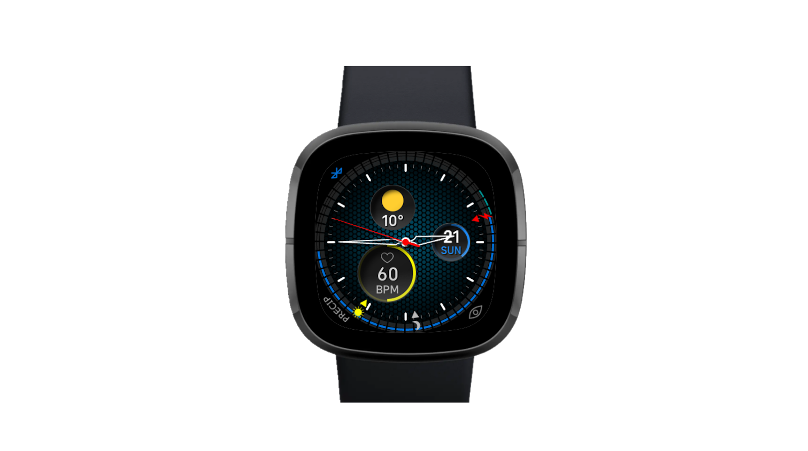
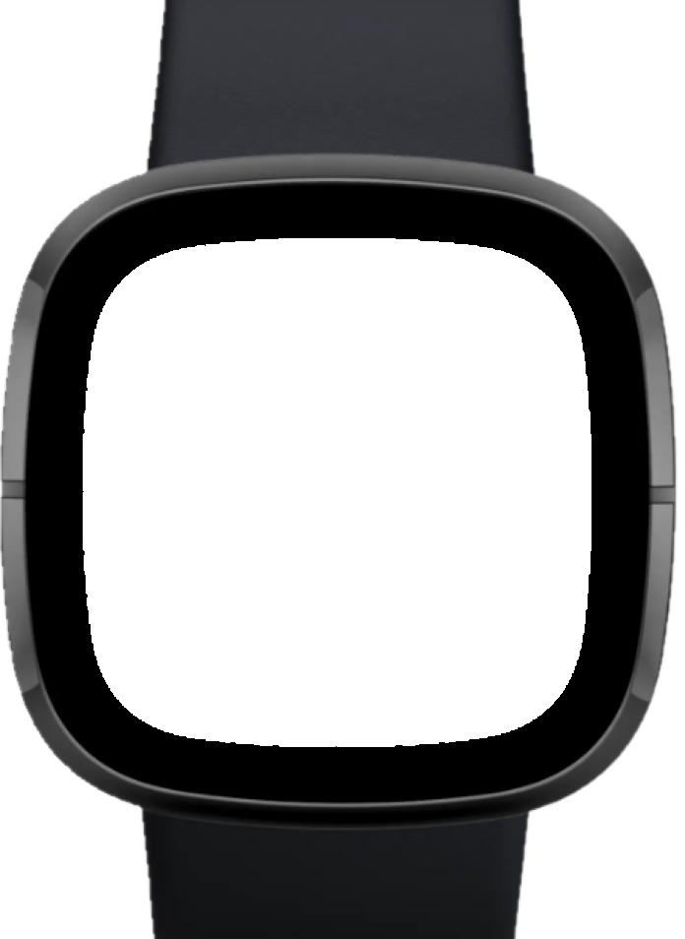
WeatherNerd
Forecast oriented watch face for:
Fitbit Versa 3
Fitbit Sense

Slide 2
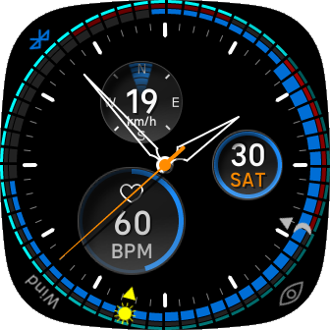
Complications
Battery dead hand
Current Weather
Connetion status
Datum
Meteo alerts
Sunset hand
Fitness data
Hands rest
Sunrise hand

Slide 3
Clock
Ice alerts
Primary alerts
Secondary alerts

Slide 4
Alerts
Ice alerts
Primary alerts
Secondary alerts

Slide 5
Widgets
Datum
Weather
Fitness

Slide 6
